Slide 1
Hello, I’m Dr. Raj Sethuraman
Professor and Harold Simmons Chair in Marketing SMU-Cox School of Business Dallas, Texas, USA
If you wish to contact me, please send an email to
rsethura@cox.smu.edu
Home
About Me
Teaching
Research
Service
Awards
Books
Talks
Consulting
Fundraising
Charity
Mentoring
Comments for web designer:
This is only the top banner (brown) part that goes on every page. Change as above and squish so it is not too tall.
Add/modify/rearrange the page tabs as above.

Slide 2
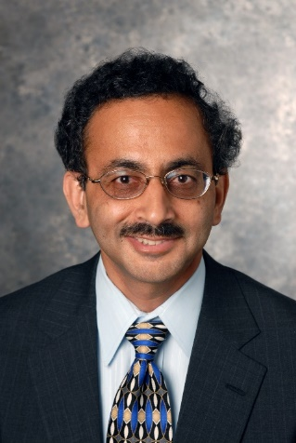
Hom e
About Me
Teaching
Research
Service
Awards
Books
Talks
Consulting
Fundraising
Charity
Mentoring
Comments for web designer:
Use this network graph for home page
Can change color/font to make them more aesthetic and appealing/impressive
Create a link to access my detailed vita/resume – pdf attached.
Engaged in & Passionate About
Academic Work
Corporate Connectivity
Giving Back
Teaching
Research
Service
Books
Talks
Consulting
Fundraising
Charity
Mentoring
15
42
11
11
70+
7
12
13
100K+
Courses Taught
Publications
Years as dept chair
Books & Cases
Talks Given
Corporate Clients
Dollars Raised
Nonprofits Helped
Students Guided
Dr. Raj Sethuraman Resume

Slide 3
Home
About Me
Teaching
Research
Service
Awards
Books
Talks
Consulting
Fundraising
Charity
Mentoring
My father was an ex-serviceman (army veteran) in India and fought for the British during World War II in the 1940s. Hence I joined Sainik (military) school on a scholarship for my high school. I then continued to complete my chemical engineering degree at the National Institute of Technology and an MBA at the Indian Institute of Management, where I specialized in marketing and operations research. Because of my undergraduate degree in chemical engineering and my graduate degree in marketing, I decided to combine the two at my workplace. So I joined an affiliate of Exxon Chemicals as a sales and marketing officer. After working for over three years, the opportunity to work with the legendary marketing guru Philip Kotler drew me to Kellogg Graduate School of Management at Northwestern University in Chicago, where I completed my Ph.D. in marketing. After spending a few years as an assistant professor at the University of Iowa, I am currently a chaired professor in the marketing department at the Cox School of Business in Southern Methodist University (SMU), where I am enjoying my academic and residential life with my wife, in-laws, and my daughter.
Here is my brief bio:
Dr. Raj Sethuraman is the Harold Simmons Professor and Chair in Marketing and the Executive Director of the Center for Marketing Management Studies at the Edwin L. Cox School of Business at Southern Methodist University, Dallas, Texas, USA. He received his Ph.D. in marketing from Kellogg Graduate School of Management at Northwestern University, after completing his undergraduate degree in chemical engineering from the National Institute of Technology in India and an MBA in marketing and operations research from the Indian Institute of Management in Calcutta.
Dr. Sethuraman has taught several marketing courses, written many cases in marketing, and introduced several online teaching tools, for which he was awarded the Eugene Byrne Teaching Innovation Award in 2010. He is currently focused on the use of data in marketing and has written many books on the subject for classroom use, including Marketing Research, Data-based Customer Insights, Thinking with Data in Marketing, and Leveraging Data in Marketing.
Professor Sethuraman’s research focuses on national brand-store brand competition, price-advertising strategies, and brand equity using economic and econometric models. He has published articles in leading journals, won many research awards, and has served as an editorial / advisory board member for reputed marketing journals, including the Journal of Marketing Research, Marketing Science, Review of Marketing Science, and the Journal of Modeling in Management. He served as the Editor-in-Chief of the Journal of Retailing from 2017 to 2022 and is currently on its advisory board.
Dr. Sethuraman is active in consulting for commercial and nonprofit organizations. His consulting engagements include Samsung Telecommunications, KPMG, and the Center for Nonprofit Management. He is also the founder-president of Charity through Art (CHAART) Foundation, a nonprofit organization started in 2008 dedicated to raising money for the underprivileged by organizing dance and music performances.
For a detailed resume, please click on the link below.
Dr. Raj Sethuraman Resume
(create a link with my attached vita)

Slide 4
Home
About Me
Teaching
Research
Service
Awards
Books
Talks
Consulting
Fundraising
Charity
Mentoring
Marketing Models
Brand Equity
Pricing
Database Marketing
Retailing
Customer Insights
Private Labels
Multivariate Analysis
15
Courses / Topics
Taught
Comments for web designer:
Include the text on top left - above the figure.
Make the circles smaller to reduce size if needed.
Competitive Strategy
Sales Management
Segmentation
B2B Marketing
Marketing
Management
Marketing Research
Leveraging Data in Marketing
Given my background in chemical engineering and work experience with Exxon Chemical, I have been fortunate to teach a wide range of strategy and data-oriented courses in marketing.
The 15 topics taught in degree and non-degree / executive programs are listed below:

Slide 5
Home
About Me
Teaching
Research
Service
Awards
Books
Talks
Consulting
Fundraising
Charity
Mentoring
I do research to gain insights about national brand-store brand competition (my thesis topic), private label marketing, price-advertising strategies, and brand equity. I use empirical, economic, econometric, and meta-analytic models to address these topics. Thus I can be labeled as an empirically-oriented, managerially-motivated researcher.
I have published 42 research articles as of Jan. 2024 (Google citations = 6091; h-index = 30). These articles are listed below in descending order of year of publication – from newest to oldest. You can access the articles for personal use by clicking on the title. I am working on eleven research projects, also listed below.
Research Publications
# | Year | Journal/Article
42 | 2022 | Sethuraman, Raj, Juan Carlos Gázquez-Abad, Francisco J. Martínez-López, "The Effect of Retail Assortment Size on Perceptions, Choice, and Sales: Review and Research Directions," under second review in the Journal of Retailing, 98 (1) – Forthcoming, March.
41 | 2021 | Dhruv, Grewal, Dinesh K. Gauri, Anne L. Roggeveen, and Raj Sethuraman, “Strategizing Retailing in the New Technology Era,” Journal of Retailing, 97 (1), 6-12
40 | 2021 | Gázquez-Abad, Juan Carlos, Francisco J. Martínez-López, and Raj Sethuraman, “What Factors Moderate the Effect of Assortment Reduction on Store Switching? Insights and Implications for Grocery Brands,” Journal of Business Research, 133, 98-115.
39 | 2021 | Gielens, Katrijn, Raj Sethuraman et al., “The Future of Private Labels: Towards a Smart Private Label Strategy,” Journal of Retailing, 97 (1), 99-115.
38 | 2020 | Roggeveen, Anne and Raj Sethuraman, “Customer-Interfacing Retail Technologies in 2020 & Beyond: An Integrative Framework and Research Directions,” Journal of Retailing, 96 (3), 299-309.
Comments for web designer:
Change tab from Publishing to Research
Include the content above and two tables below.
In the first table on Research Publications, see if you can link each paper to the corresponding journal article.

Slide 6
# | Year | Journal/Article
37 | 2020 | Roggeveen, Anne and Raj Sethuraman, “How the COVID-19 Pandemic May Change the World of Retailing,” Journal of Retailing, 96 (2), 169-171.
36 | 2018 | Roggeveen, Anne and Raj Sethuraman, “Understanding the JR Heritage, Publishing in JR, and the Evolving Retail Field,” Journal of Retailing, 94 (1), 1-4.
35 | 2018 | Sethuraman, Raj, “Consumer Preference Distributions and Corresponding Store Brand Strategies: A Compilation,” Chapter 8 in Handbook of Research on Retailing. K. Gielens and E. Gijsbrechts, eds. Edward-Elgar Publishing, August.
34 | 2016 | Roy, Subhadip, Rashmita Saran and Raj Sethuraman, "Personality and Fashion Consumption: A Conceptual Framework in the Indian Context" Journal of Fashion Marketing and Management, 20 (2), 157-176.
33 | 2016 | Roy, Subhadip, Raj Sethuraman, and Rashmita Saran, “The Effect of Demographic and Personality Characteristics on Fashion Shopping Proneness: A Study of the Indian Market," International Journal of Retail & Distribution Management, 44 (4), 426-447.
32 | 2015 | Voleti, Sudhir and Raj Sethuraman, “Are National Brands more Promotion Elastic than Store Brands?” Advances in National Brand and Private Label Marketing, Second International Conference Proceedings, Springer, Germany, June (pp. 63-70)
31 | 2014 | Sethuraman, Raj and Katrijn Gielens, “Determinants of Store Brand Share,” Journal of Retailing, 90 (June), 141-153.
30 | 2013 | Sethuraman, Raj and Jagmohan Raju, "The Competition between National Brands and Store Brands: Models, Insights, Implications, and Future Research Directions," Foundations and Trends® in Marketing 7, no. 1: 1‐108.
29 | 2012 | Sethuraman, Raj and Jagmohan Raju, “Private Label Strategies – Myths and Realities,” Handbook of Marketing Strategy, Edward Elgar Publishing Ltd., Glasgow, U.K. (pp. 318-335).
28 | 2011 | Sethuraman, Raj, Gerard Tellis, and Richard Briesch, “How Well Does Advertising Work? Generalizations from Meta-Analysis of Brand Advertising Elasticities,” Journal of Marketing Research, 47 (June) 457-471.
27 | 2009 | Sethuraman, Raj, “Assessing the External Validity of Analytical Results from National Brand and Store Brand Competition Models,” Marketing Science, 28 (4), 759-781.
26 | 2008 | Sethuraman, Raj, “There is Nothing More Practical than the Practice of Theory: What Practitioners Think about Theoretical Results on National Brand – Store Brand Competition,” Marketing Science Institute Special Report No. 08-209 (November).
25 | 2006 | Sethuraman, Raj, “Private Label Marketing Strategies in Packaged Goods; Management Beliefs and Research Insights,” Marketing Science Institute Working Paper No. 06-108 (June).
24 | 2005 | Fox, Edward J. and Raj Sethuraman, “Retail Competition,” invited book chapter in Retailing in the 21st Century, Springer, Heidelberg: Germany, pp. 193-210.
23 | 2005 | Sethuraman, Raj, Roger Kerin, and William Cron, “A Field Study Comparing Online and Offline Data Collection Methods for Identifying Product Attribute Preferences Using Conjoint Analysis,” Journal of Business Research, 58 (May), 602-610.

Slide 7
# | Year | Journal/Article
22 | 2005 | Sethuraman, Raj and A. Parasuraman, “Succeeding in the Big Middle Through Technology,” Journal of Retailing, 81(2), 107-111.
21 | 2004 | Sethuraman, Raj, “Positioning Store Brands against National Brands: Get Close or Keep a Distance?” SMU-Cox School of Business Working Paper.
20 | 2003 | Sethuraman, Raj, “Measuring National Brands’ Equity over Store Brands,” Review of Marketing Science, 1 (2), 1-26.
19 | 2002 | Sethuraman, Raj and Gerard Tellis, “Does Manufacturer Advertising Suppress or Stimulate Retail Price Promotion? Analytical Model and Empirical Analysis,” Journal of Retailing, 78 (4), 253-263.
18 | 2002 | Sethuraman, Raj and V. Srinivasan, “The Asymmetric Share Effect: An Empirical Generalization on Cross-Price Effects,” Journal of Marketing Research, 39 (August), 379-386.
17 | 2000 | Sethuraman, Raj, “What Makes Consumers Pay More for National Brands than for Store brands: Image or Quality?” Marketing Science Institute Working Paper No. 00-110 (November).
16 | 1999 | Sethuraman, Raj, V. Srinivasan, and Doyle Kim, “Asymmetric and Neighborhood Cross-Price Effects: Some Empirical Generalizations,” Marketing Science, 18 (1), 23-41.
15 | 1999 | Sethuraman, Raj and Catherine Cole, "Factors Influencing the Price Premiums that Consumers Pay for National Brands over Store Brands?” Journal of Product and Brand Management, 8 (4), 340-351.
14 | 1999 | Kerin, Roger and Raj Sethuraman, “Revisiting Marketing’s Lawlike Generalizations: A Comment,” Journal of the Academy of Marketing Science, 27 (Winter), 101-104.
13 | 1998 | Kerin, Roger and Raj Sethuraman, “Exploring the Brand Value – Shareholder Value Nexus for Consumer Goods Companies,” Journal of the Academy of Marketing Science, 26 (Fall), 260-273.
12 | 1997 | Sethuraman, Raj and Catherine Cole, "Why Do Consumers Pay More for National Brands over Store Brands? Marketing Science Institute Working Paper No. 97-127 (December).
11 | 1996 | Sethuraman, Raj, "A Model of How Discounting High-Priced Brands Affects the Sales of Low-Priced Brands," Journal of Marketing Research, 33 (November), 399-409.
10 | 1995 | Sethuraman, Raj, “A Meta-Analysis of National Brand and Store Brand Cross-Promotional Price Elasticities,” Marketing Letters, 6 (4), 275-286.
9 | 1995 | Raju, Jagmohan, Raj Sethuraman, and Sanjay Dhar, "The Introduction and Performance of Store Brands," Management Science, 41 (June), 957-978.

Slide 8
# | Year | Journal/Article
8 | 1995 | Raju, Jagmohan, Raj Sethuraman, and Sanjay Dhar, "National Brand – Store Brand Price Differential and Store Brand Market Share," Pricing Strategy & Practice: An International Journal, 3 (2), 17-24.
7 | 1995 | Sethuraman, Raj, "National Brand and Store Brand Price Competition: Who Hurts Whom?" Marketing Science Institute Technical Working Paper No. 95-105.
6 | 1994 | Sethuraman, Raj, Cathy Cole and Dipak Jain, "Analyzing the Effect of Information Format and Task on Cutoff Search Strategies," Journal of Consumer Psychology, 3 (2), 103-136.
5 | 1992 | Sethuraman, Raj and John Mittelstaedt, "Coupons and Private Labels: A Cross-Category Analysis of Grocery Products," Psychology & Marketing, 9 (6), 487-500.
4 | 1992 | Sethuraman, Raj, "The Effect of Marketplace Factors on Private Label Penetration in Grocery Products," Marketing Science Institute Working Paper No. 92-128.
3 | 1991 | Sethuraman, Raj and Gerard J. Tellis, "An Analysis of the Tradeoff Between Advertising and Price Discounting," Journal of Marketing Research, 28 (May), 160-174.
2 | 1991 | Sethuraman, Raj, “Analysis of National Brand – Store Brand Competition,” Working Paper, University of Iowa, Iowa City, IA
1 | 1988 | Sethuraman, Raj, James C. Anderson, and James A. Narus, "Partnership Advantage and its Determinants in a Distributor and Manufacturer Working Relationships," Journal of Business Research, 17 (4), 327-347
Research in Progress – [put right after Research Publications]

Slide 9
Research in Progress
# | Research Title
1 | Introducing Palate as a Driver of Consumer Choice and Recommending Marketing Strategies Conducive To Palate-Driven Choice
2 | Product Price Level and Retail Price Promotions: An Empirics-First Analysis of Promotional Effect and Implications for Theory and Practice
3 | 10 Years of the Journal of Retailing: A Retrospective Outlook
4 | The Many Faces of Private Labels: A Taxonomy of Private Label Strategies
5 | Is there a Law of Numbers when it comes to Consumer Choice? An Experimental Analysis
6 | The Effect of Product Assortment on Brand Choice in Retailing: An Analysis of Store and Panel Data
7 | Crowning the Queen or King of Citation in Marketing!
8 | A Review of Meta-Analysis in Marketing and A Meta-analysis of the Impact of Digital Advertising
9 | Inferring Attribute Dynamics from Brand Sales Data
10 | Positioning Store Brands against National Brands: Get Close or Keep a Distance?
11 | The Effect of Consumer Brand Equity on Firm Brand Profitability

Slide 10
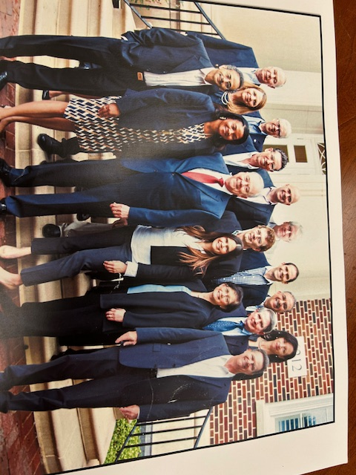
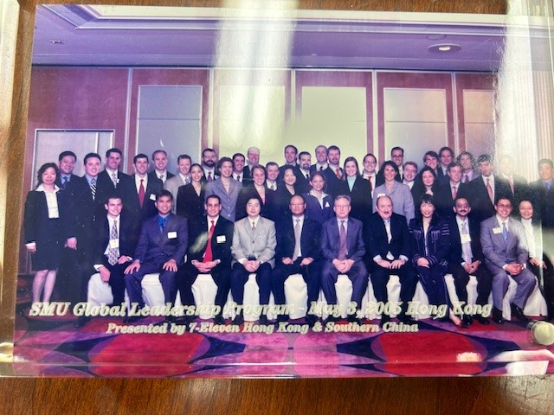
Home
About Me
Teaching
Research
Service
Awards
Books
Talks
Consulting
Fundraising
Charity
Mentoring
Besides being a member of numerous college committees and a reviewer for several academic journals, I was fortunate to lead the marketing department as chairperson for 11 years (2008-19) and the Journal of Retailing as its editor-in-chief for 5 years (2017-22). Key service assignments are listed below:
Key Service Assignments
2020 - Member – University Educational Programs Committee
2017 – 2022 Editor-in-Chief, Journal of Retailing
2014 - 2019 Director - Graduate Marketing Certificate Program
2015 – 2019 Member - University Research Council
2013 -- 2017 Chair – Presidential Scholars Interview Team
2009 – 2014 Member - Senate subcommittee on Admissions and Aid
2005 – 2014 Member - University Admissions Council
2005 - 2008 Member – Faculty Senate
2007 – 2017 Member - Presidential Scholars Selection Committee
2003 – 2006 Member – Strategic Enrolment Management Committee
2003 - 2005 Chair - President’s Commission on Status of Racial Minorities
2009 - 2019 Chair – BBA Policy Planning Committee
2014 - 2019 Director - Graduate Marketing Certificate Program
2008 – 2019 Chair – Department of Marketing at SMU-Cox
2002 – 2008 Faculty Advisor: Global Leadership Program for MBAs
2000 - Editorial/Advisory Board member, Reviewer of Marketing Science, Journal of Marketing Research, Journal of Retailing, and many other marketing journals.
Raj Sethuraman with MBAs at the
SMU Global Leadership – Hong Kong
(Photo taken 2005)
SMU-Cox Marketing Faculty
with Dean Niemi and Department Chair Raj Sethuraman
(Photo taken 2016)
Comments for web designer:
Use above content
Place good photos on the side with the indicated caption. What you see are just placeholders.

Slide 11
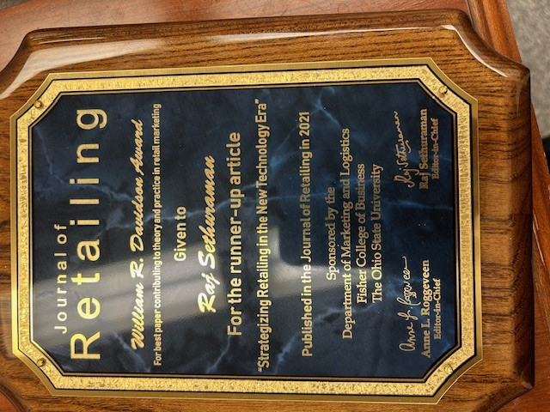
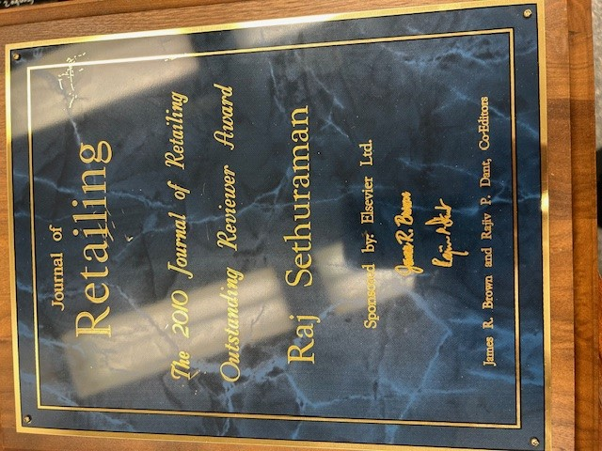
Home
About Me
Teaching
Research
Service
Awards
Books
Talks
Consulting
Fundraising
Charity
Mentoring
I have received 11 research awards, 9 research grants, 2 teaching awards, and 1 service award. Mementos presented by organizations are displayed below.

Slide 12
Comments for web-designer
Let this slide be continuation f previous slide on service page (as scroll down)
There are 20 award displays of various kinds, sizes, and shapes. What you see are just place holders.
Photos of all award plaques to be taken and positioned so they are seen well and readable.

Slide 13
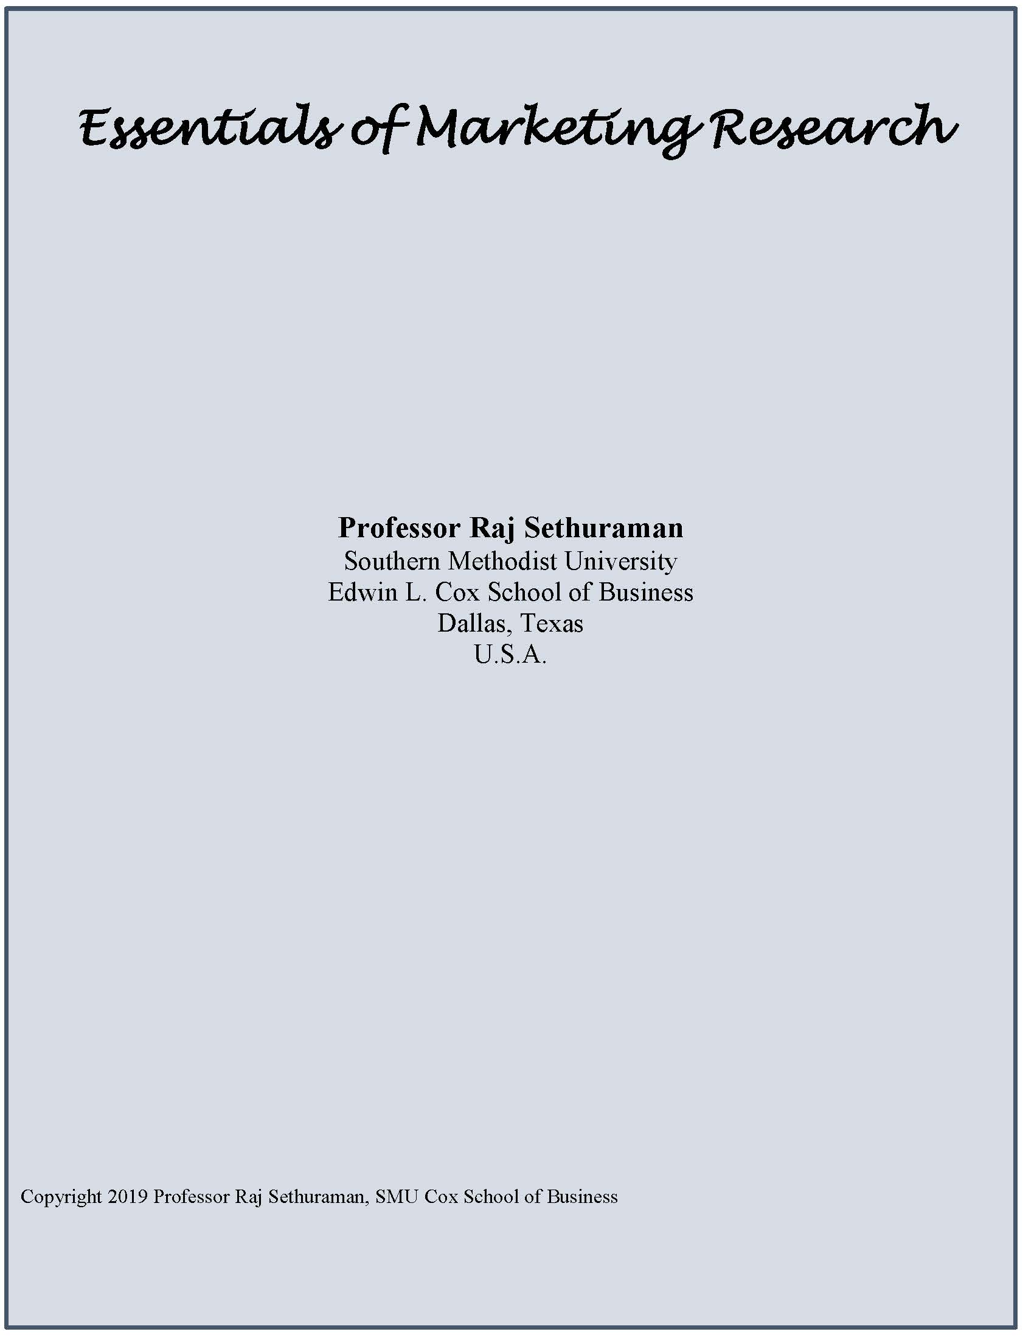
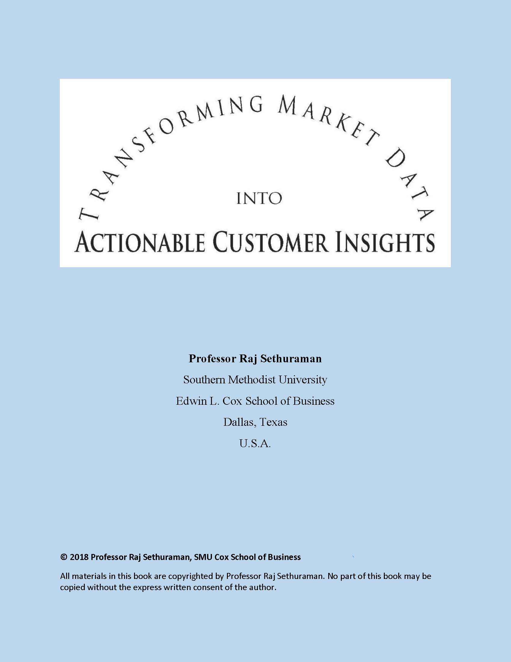
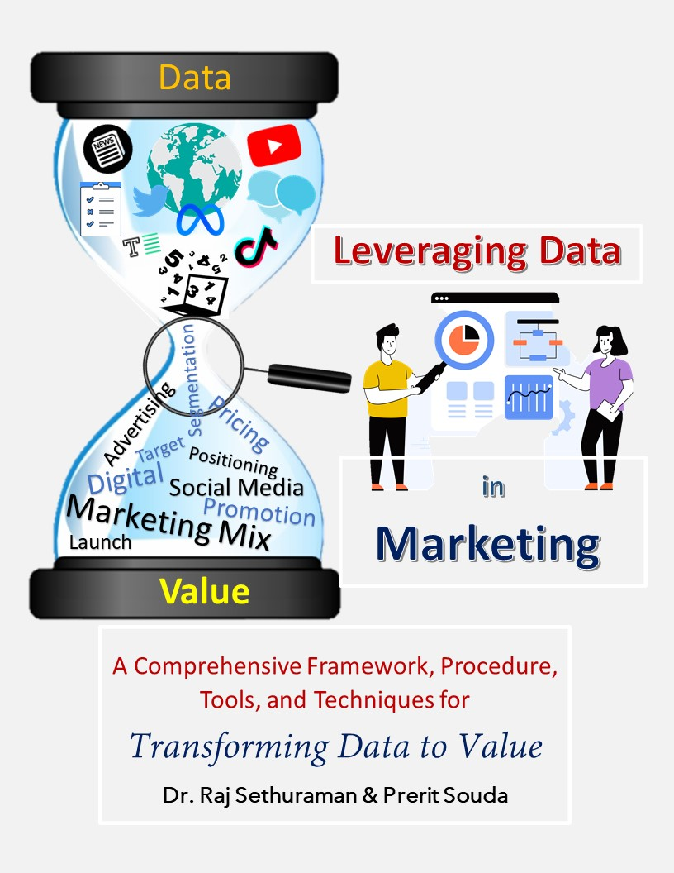
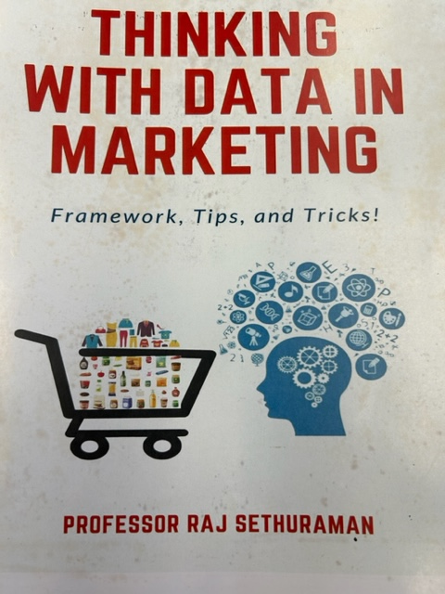







Home
About Me
Teaching
Research
Service
Awards
Books
Talks
Consulting
Fundraising
Charity
Mentoring
I have written 4 books and 7 cases, primarily for internal classroom use. But some of them have been already published or will be published.
Books (4)
Cases (7)

Slide 14
Home
About Me
Teaching
Research
Service
Awards
Books
Talks
Consulting
Fundraising
Charity
Mentoring
Recent Keynote and Other Invited Talks
2023 Paari Institute of Management, India
2023 FORE Institute, Delhi, India
2022 Jio Institute, Mumbai, India
2021 FORE International Marketing Conference, Delhi, India
2021 New Castle University, UK
2021 Flame University, Pune, India
2021 Birla Institute of Management and Technology, India
2021 American Collegiate Retailing Association
2021 McGill University, Canada
2020 Birla Institute of Management Technology Retail Summit, India
2019 Wharton Marketing Seminar, University of Pennsylvania, Philadelphia
2019 Italian Marketing Conference, Piacenza, Italy
2019 Symbiosis Institute, Pune, India
2019 KU Leuven Retail Research Conference, Leuven, Belgium
2018 Indian Institute of Management, Bangalore, India
2018 Faculty development workshop – Jindal Institute, New Delhi, India
2018 Syracuse University, Syracuse, USA
2018 Advances in National Brand and Private Label Marketing, Barcelona, Spain
1989–2015 Over 60 invited talks and conference presentations

Slide 15







Home
About Me
Teaching
Research
Service
Awards
Books
Talks
Consulting
Fundraising
Charity
Mentoring
Served as Ad-hoc Consultant For

Slide 16



Home
About Me
Teaching
Research
Service
Awards
Books
Talks
Consulting
Fundraising
Charity
Mentoring
Founder-President (Since 2008)
Charity through Art (CHAART) Foundation was formed in 2008
As a 501c3 U.S. based nonprofit organization.
The sole purpose of the foundation is
To organize Dance and Music concerts
To raise Funds for Dedicated Charities
Who provide Food and Education
To poor Children around the Globe
So Far (2008-2024)
We have organized / coordinated
About 70 dance/music concerts
Raised over US$100,000 and
Distributed to 20 global nonprofit organizations
Supporting our cause
For more details visit www.chaartfoundation.org
Flyer for a 2023 dance performance organized by CHAART
Flyer for a 2011 dance performance organized by CHAART

Slide 17





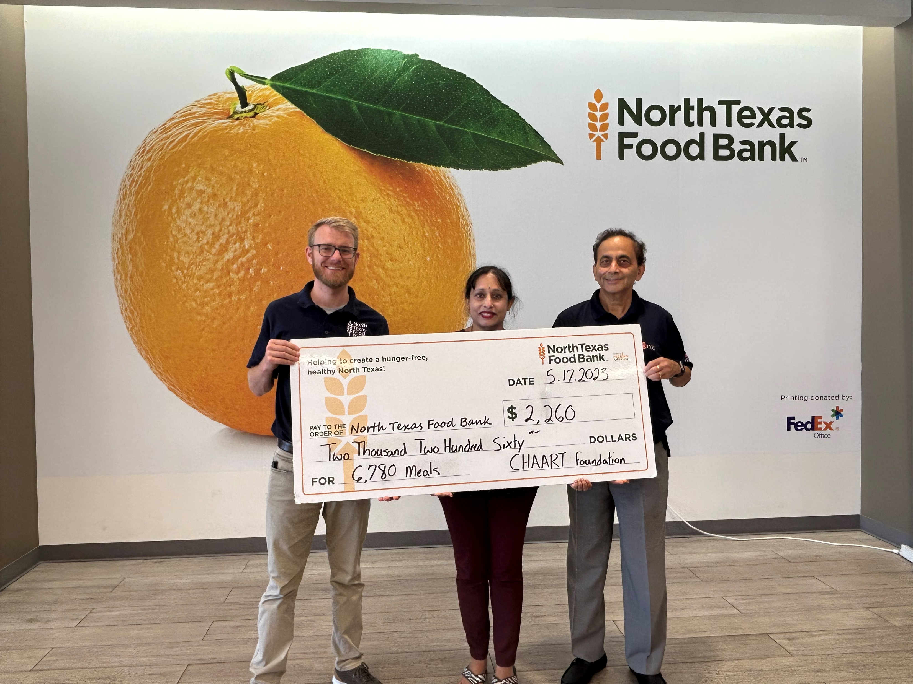







Home
About Me
Teaching
Research
Service
Awards
Books
Talks
Consulting
Fundraising
Charity
Mentoring
12 Non-Profits Supported through CHAART
Providing Food and Education to Poor Children Around the Globe
CHAART Donation Received by Johny, NTFB Coordinator, Plano, TX
(Photo taken May 2023)

Slide 18
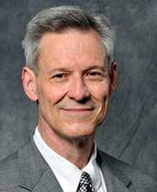
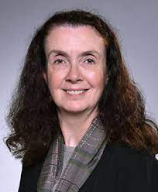
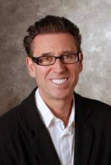
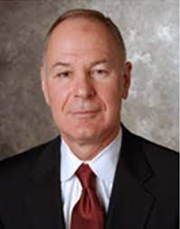
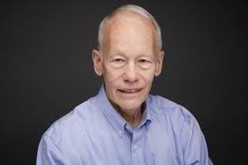
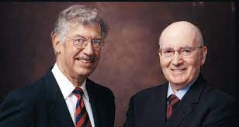
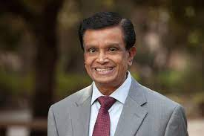
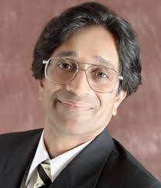
Home
About Me
Teaching
Research
Service
Awards
Books
Talks
Consulting
Fundraising
Charity
Mentoring
My Mentees
As an instructor for over 30 years, I have had the pleasure of teaching hundreds of students and hired some of them as my teaching/research assistants. Beyond teaching and assistantship, I am pleased to have had the opportunity to advice/mentor the following students:
Ph.D. Students (as coauthor, thesis committee member, research advisor)
Suresh Diwaker, Doyle Kim, John Mittelstaedt
Masters Students (as general advisor, help with startup)
Vishal Ahuja, Bala Ganapathy, Madhuri Manjunath, Larissa Spies, Tegan Webster
Undergrad/High-School Students (as general advisor, recommender)
Mahika Bansal, Arnav Lavanuru, Lakshana Nattamai, Laya Rajaram, Arvind Venkataraman
My Mentors
Every mentor is also a mentee. During my formative years, and even now, I have been guided by many mentors who have directly or indirectly influenced me through their advice and critique. They have been instrumental in bringing out my best and I owe a big thanks to them!
James Anderson
Faculty Advisor
Anne Coughlan
Thesis Advisor
Bill Dillon
Academic Supervisor
Roger Kerin
Coauthor
Don Lehmann
Role Model
Louis Stern & Philip Kotler
Kellogg Professors
Seenu Srinivasan
Coauthor
Gerry Tellis
Coauthor

